Slide 1
Supply Chain Exploratory Data Analysis & Machine Learning Predicting for Late Delivery Risk
PPresented By : - Ahmed Qenwy - Amir Essam - Ali Gomaa - Mohamed Samy
5/23/2025
5/23/2025

Slide 2
- Project Idea
-- Our Project aims to Anlalyze Supply Chain Process from Ordering to Shipping, and know what makes Most of Orders be shipped late. - Analyze Highest and Lowest Values by Sales, Orders, on the online store Vists - Conduct ML models for Late Delivery Risk to provide Predections based on the data -- Our Solution is to provide a Clear perspective describing areas to develop, and how some variabbles affect other variables

Slide 3
End Users + Features
Our End Users and Stakeholders: - Business ( CEO of the Company, Head of Operations, Supply Chain Manager ) who look forward to developing their business and winning Customer Satisfaction. -- Our Analysis will provide a clear perspective for all of them by present data visuals that help to find the problem and solve it.

Slide 4
: Programming Languages + Tools
- Languages Used : * Python ( pandas, Matplotlib, seaborn, knn, random forest, logistic regression ) * SQL Tools : Excel Power BI

Slide 5
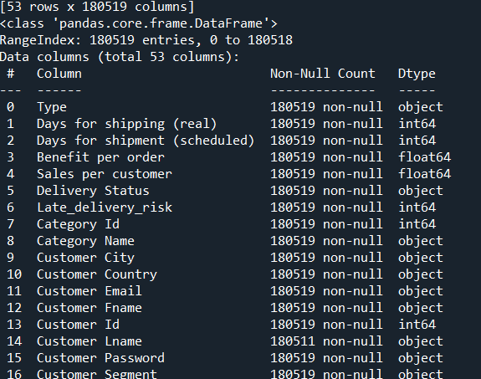
Data Structure
Show all the columns with its data type:
we have
53 columns
180518 rows
with data types
object ( 24 column)
int (14 column)
float (13 column)

Slide 6
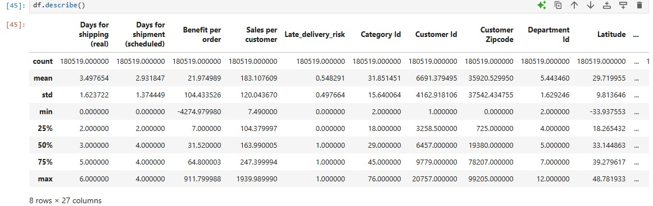
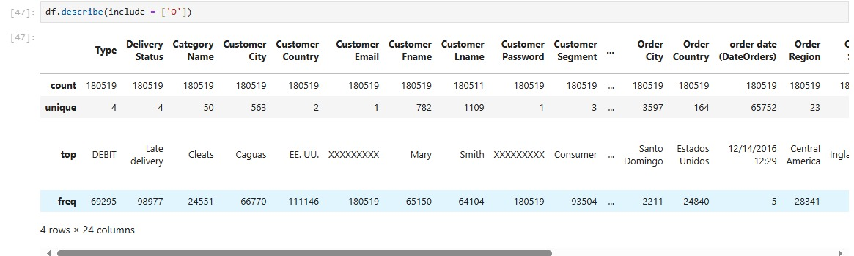
Data Structure
Showing Numeric and Object Data Types: )There are data errors in the Customer Email & Password Column(

Slide 7
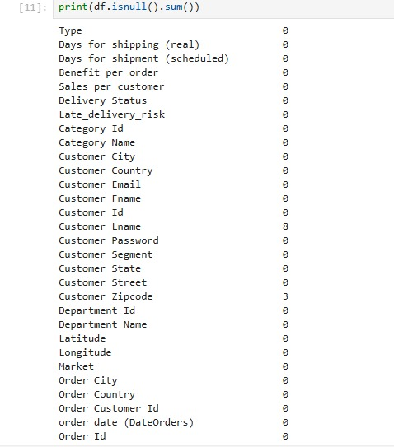
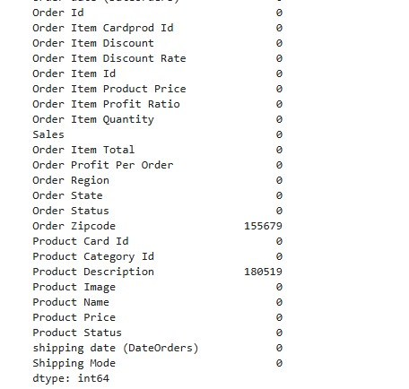

Data Structure
Checking duplicates and null values :

Slide 8

Data Preprocessing
Removing Errors, and Cleaning ( using Python, SQL, Excel ):
Drop Null columns
Finding and Replacing Errors in Customer Zip code

Slide 9



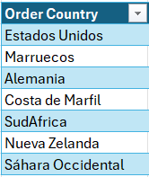
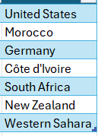

Data Preprocessing
Removing Errors, and Cleaning ( using Python, SQL, Excel ):
Removing Columns with Errors ( Customer Email & Password )
Transform and replace Spanish Text to English to avoid any errors in plotting and visualization

Slide 10
Data Normalization
( using Power Query Editor )
We conduct Data Normalization according to data Normalization standards and techniques in order to maintain consistency and make our Analysis process faster : by separating our row data after cleaning to related columns as follows by Duplicate Queries : - Full Data ( To help in machine learning ) - Orders - Order Items - Customers - Categories - Departments - logs ( Visits on the Online store )(

Slide 11
After that, we conduct more Cleaning, Removing Errors, Transformation and Optimization using SQL

Slide 12
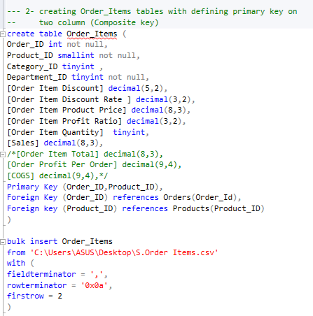
SQL
Create table OrderItems With Composite Primary key

Slide 13
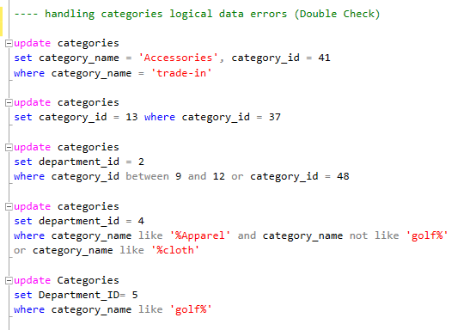
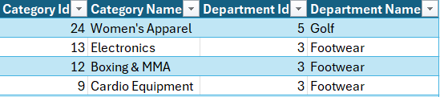
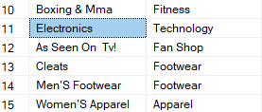

SQL
Data Cleaning, Transformation and Optimization
(Because our Categories and Departments data are conflicting as shown, We corrected it using a double check to give accurate insights and avoid data misleading info.)

Slide 14
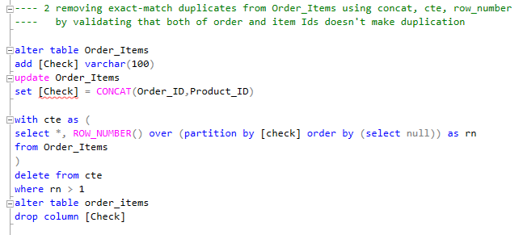
SQL
Remove Duplicates Errors in Order Items

Slide 15
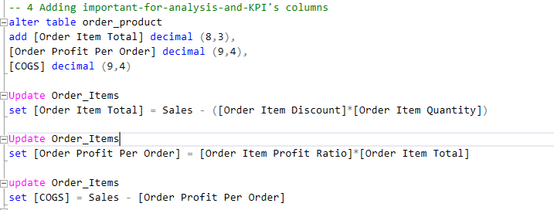
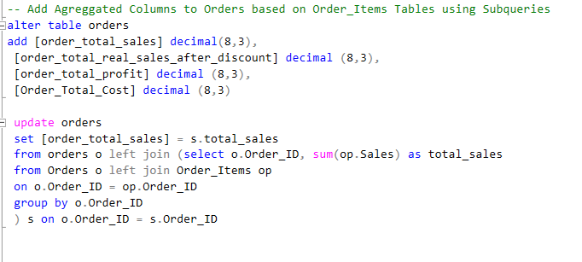
SQL
Adding Important_for_analysis_columns & Adding Aggregated columns to Orders based on calculations on order_items table
( using SQL subqueries )

Slide 16
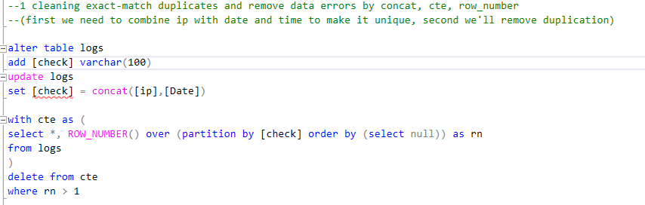
SQL
Logs Data Cleaning, Transformation, and Database Optimization

Slide 17
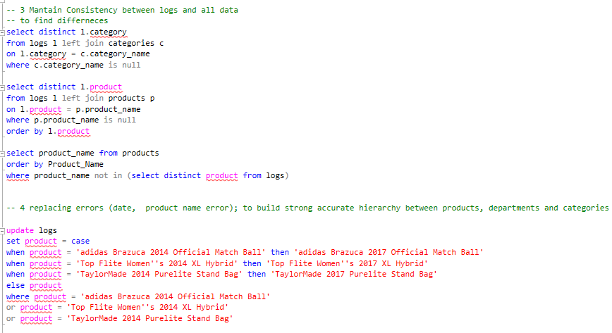
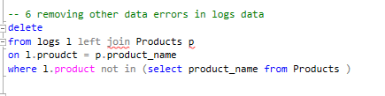
SQL
Find Differences and Replacing Errors

Slide 18
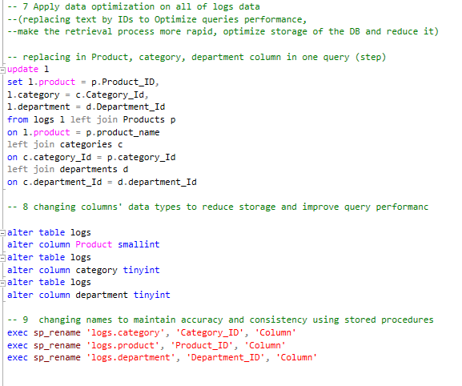
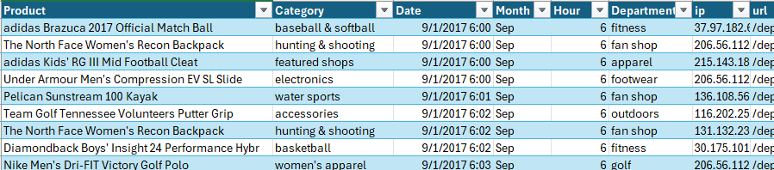
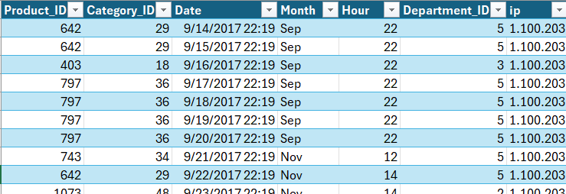
SQL
Powerful Database Optimization
The Result

Slide 19
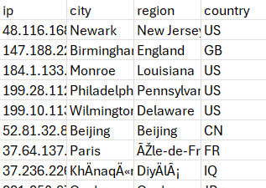
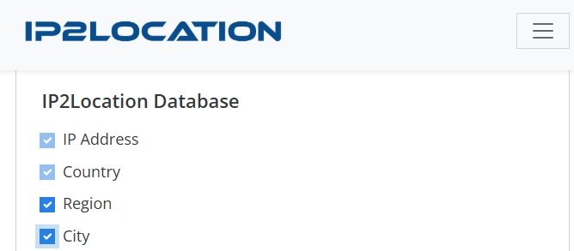
SQL
Create new data set with Ips geo info.
And make relationship between logs data

Slide 20


SQL
To maintain Consistency between Ips and all of data : We had to convert Country ISO code to Country Name
Make Region column assign with our main data to maintain consistency

Slide 21
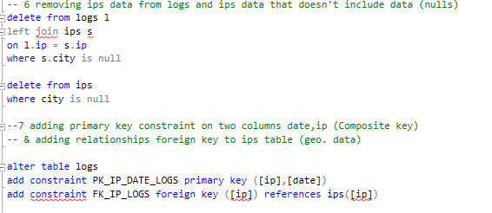
SQL
Removing Errors and adding Composite Key to IPs data

Slide 22
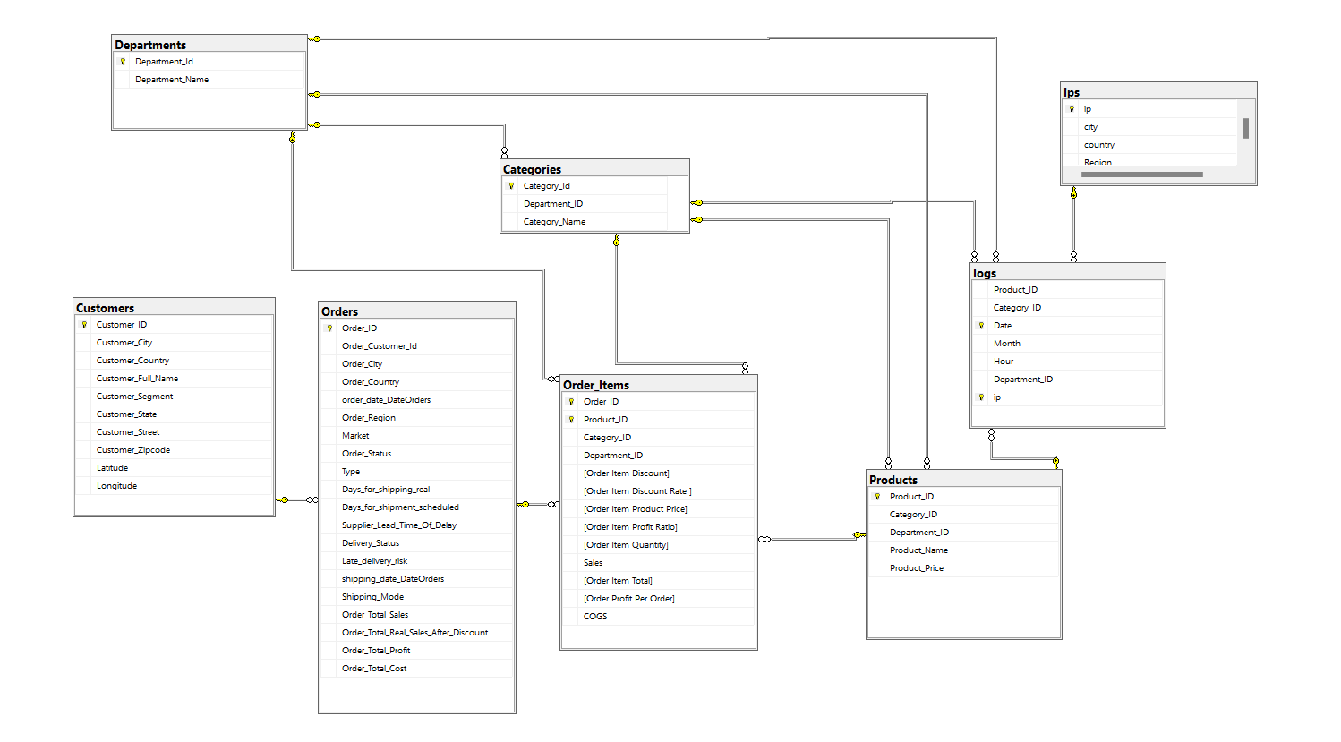
Schema

Slide 23
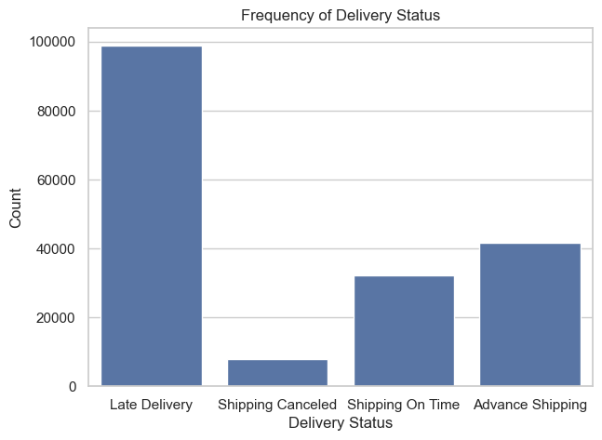
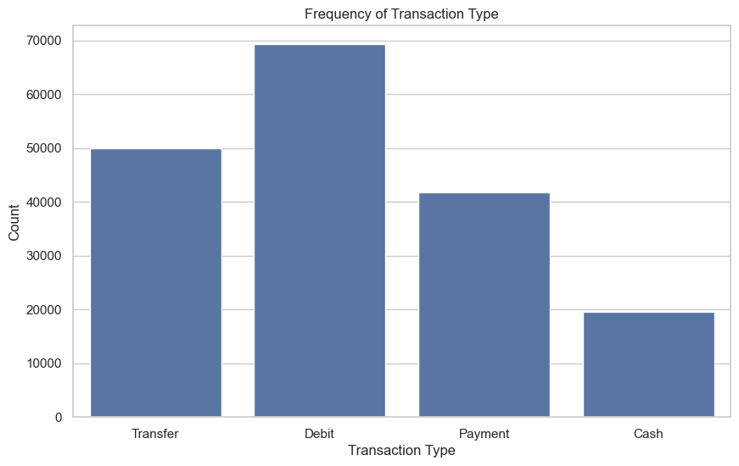
Data Visualization (Python)

Slide 24
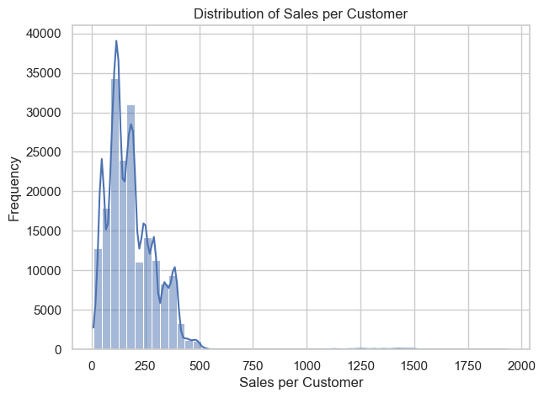
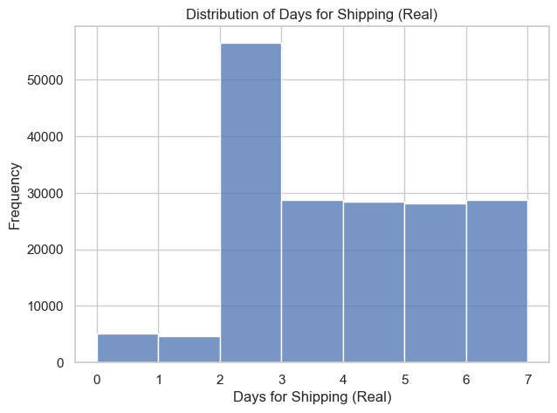
Data Visualization (Python)

Slide 25
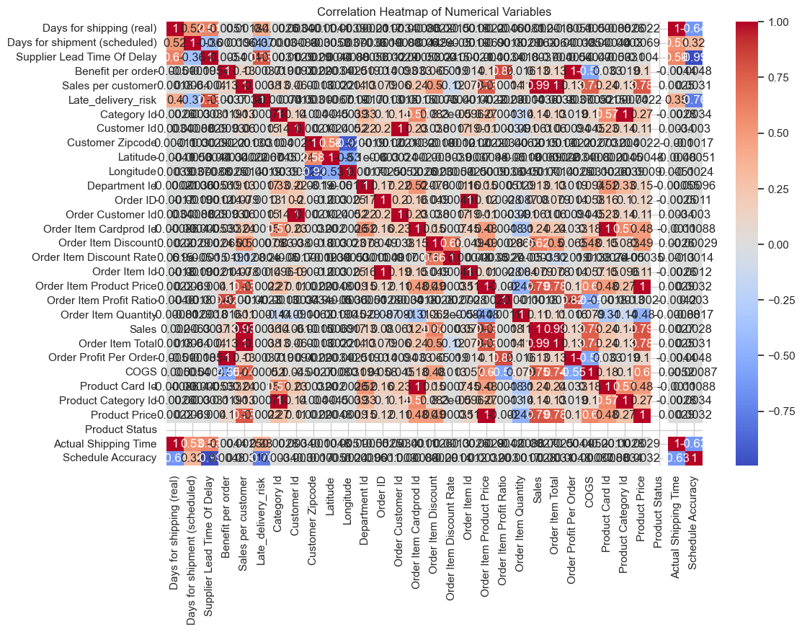
Data Visualization (Python)

Slide 26
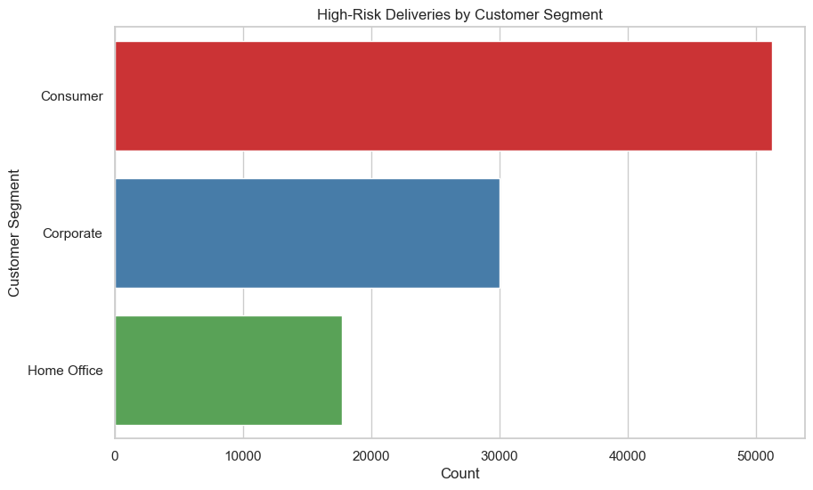
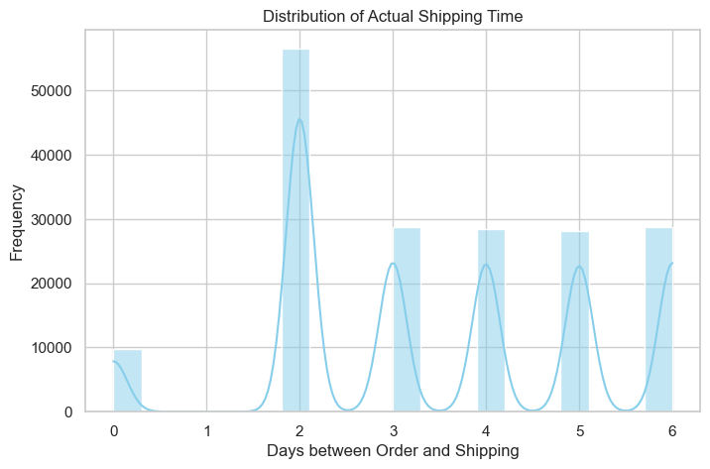
Data Visualization (Python)

Slide 27
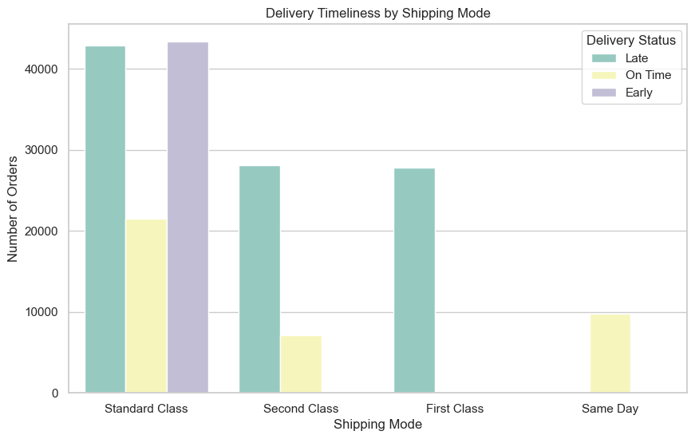
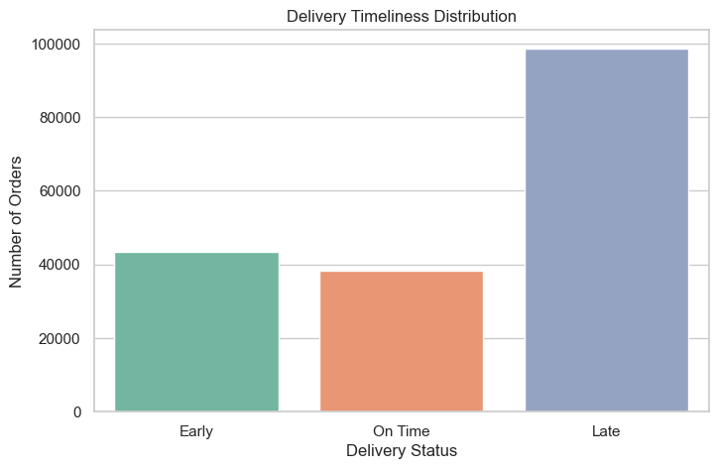
Data Visualization (Python)

Slide 28
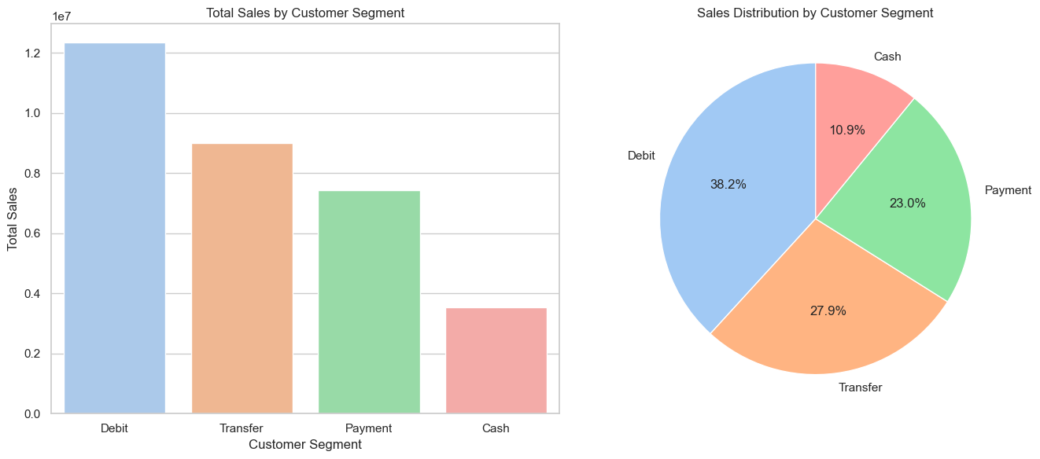
Data Visualization (Python)

Slide 29
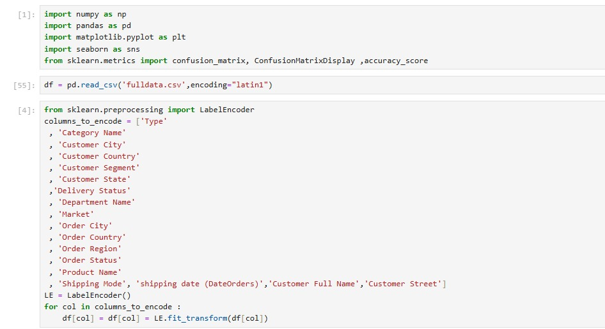
Machine Learning

Slide 30
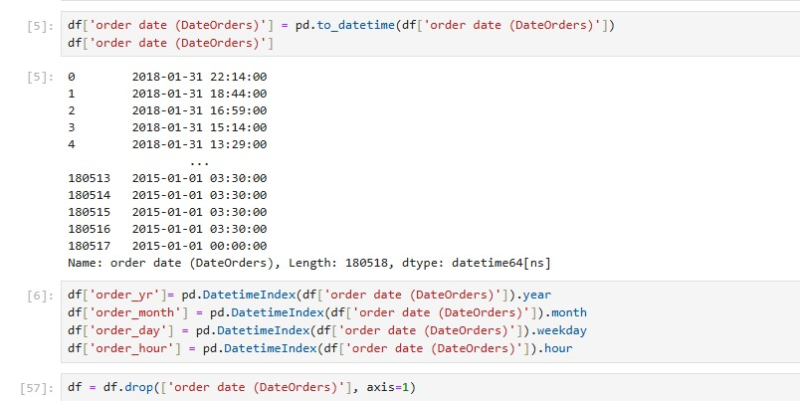
Machine Learning

Slide 31
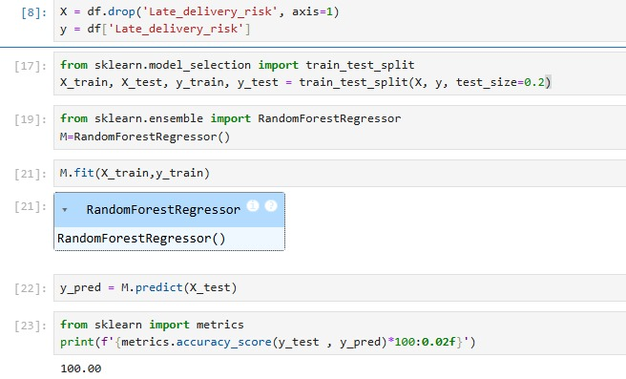
Machine Learning

Slide 32
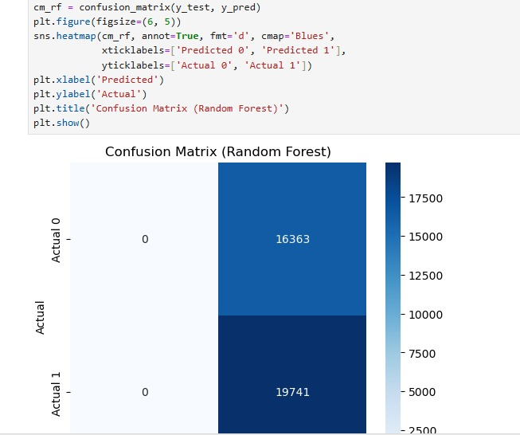
Machine Learning

Slide 33
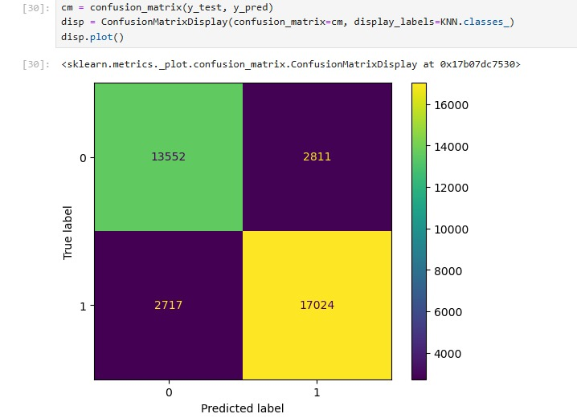
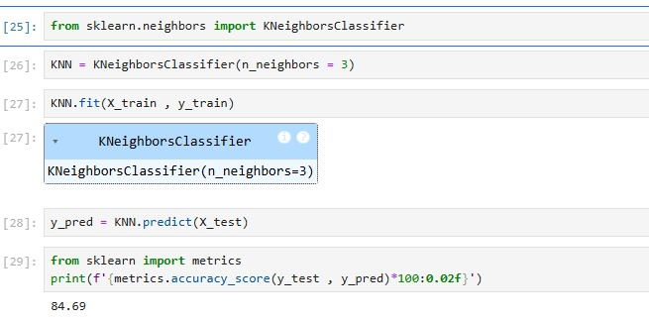
Machine Learning

Slide 34

- Project Team + Roles
- Ahmed Qenawy : ( Data Collecting, Cleaning, Optimization, SQL answering Questions, Reporting )
- Amir Essam ( Data Cleaning, ML, SQL Answering Questions, Visualization ) - Ali Gomaa ( SQL Answering Questions, Data Visualization ) - Mohamed Samy ( Data Preprocessing, ML, Presentaion )
5/23/2025

Slide 35
Do You Have Questions?

Slide 36
Thank You
Contact Info: - Ahmed Qenawy: 01223979888 - Amir Essam : 01159323667 - Ali Gomaa : 01144809788 - Mohamed Samy : 01009657475

